Slide 1
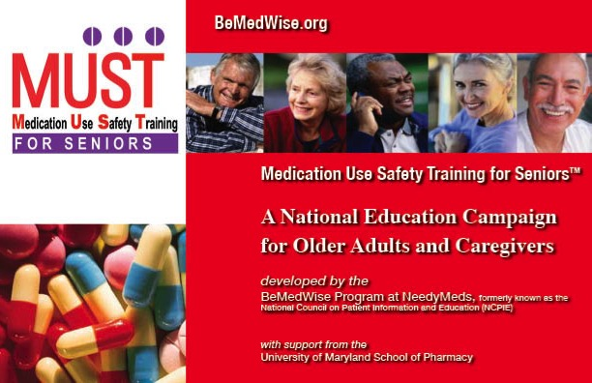
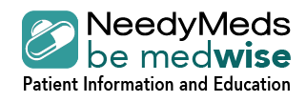
BeMedWise

Slide 2
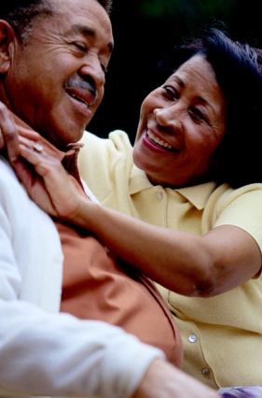
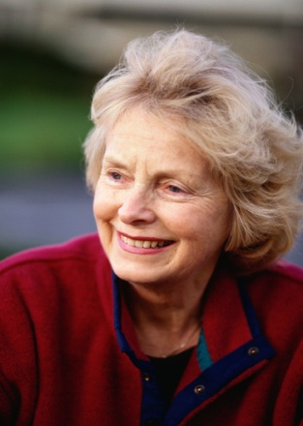
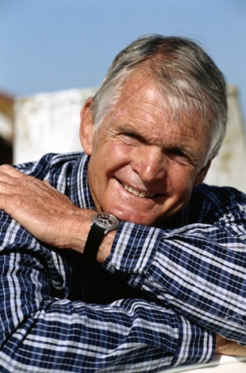
Why Are We Here Today?
After viewing this program, older adults and their caregivers will be able to discuss:
The general risks and benefits of medication therapy.
Differences between prescription medicines and
over-the-counter (nonprescription) medicines.
Common medicine use problems.
Ways to improve medicine use safety:
Quality communication with healthcare professionals.
Keeping a Medicine List.
Understanding the OTC Drug
Facts Label.
BeMedWise

Slide 3
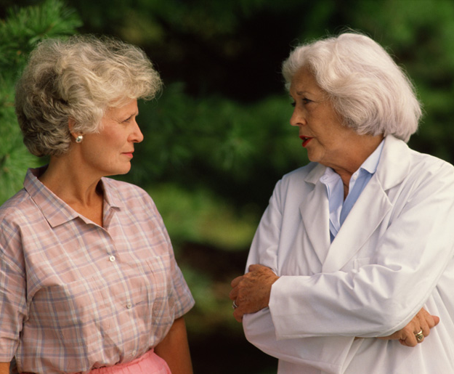
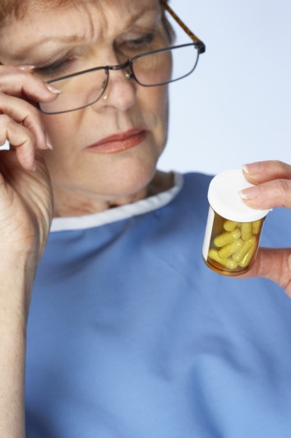
Medicines - Benefits
What is a medicine?
A medicine or drug changes how your body works.
or
Treats or prevents a disease or symptom.
When used correctly, medicines can lead to:
Better life quality
Healthier life
Longer life
BeMedWise

Slide 4
Types of Medicines
Prescription medicines
Examples: blood pressure medicines, blood thinners, antibiotics, eye drops
Over-the-Counter (OTC) or nonprescription medicines
Examples: aspirin, acetaminophen, cough medicine
For all medicines, you must read and follow the directions!
BeMedWise

Slide 5
Prescription and Nonprescription or Over-the-Counter (OTC) Medicines
BeMedWise

Slide 6
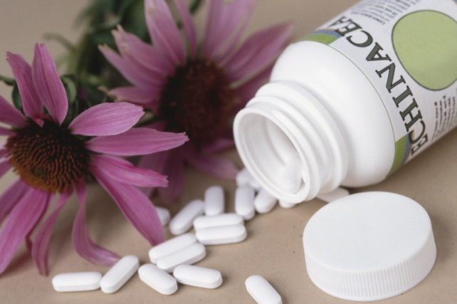
Dietary Supplements & Herbal Remedies
Self prescribed, available from many sources.
You are responsible for choosing the correct medicine, dose, and watching for side effects.
Herbal remedies do not have to follow the same strict rules that prescription drugs do.
For herbal remedies, manufacturers do not have to prove that the product is safe, effective, or that it contains the ingredients on the label.
BeMedWise

Slide 7
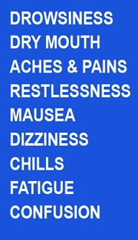
Medicines - Risks
It is important to know that ALL medicines, both prescription and OTC, have risks as well as benefits.
The risks of medicines are the chances that something unwanted or unexpected could happen to you when you
use them.
Risks could be less serious things such as an upset stomach, or more serious things, such as liver damage.
BeMedWise

Slide 8
Medicine Risks
Medicines can cause problems, even if used correctly:
Allergic reaction: when your body’s defense system reacts in a bad way to a drug.
Hives, itching, rash
Narrowing of throat, difficulty breathing, shortness of breath
vs.
Side effect: undesired effect of a medicine
Some side effects are common (headache, upset stomach).
Others are very rare (liver failure).
Side effects can occur even though the medicine is being taken correctly at the normal dose.
It is important that you inform all healthcare providers of your medicine allergies!
BeMedWise

Slide 9
Medicine Use Problems
What are Medicine Use Problems?
Medicine use problems are any “bad” things that can happen to you as a result of taking only one medicine or several medicines.
Medicine use problems can result in your not getting the best results from your medicine.
Medicine Use Problems can:
Prevent you from getting well as fast as you would like to.
Make you sicker.
Lower your quality of life.
Cause disabilities, accidents, or injuries.
BeMedWise

Slide 10
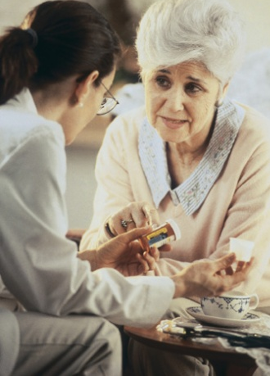
Potential Medicine Use Problems
Over use – Taking more than prescribed or recommended by the healthcare provider or label. Taking unnecessary medicines.
Under use –Taking less than prescribed or recommended, or by missing or skipping doses.
Not following instructions for use carefully.
Drug interactions
BeMedWise

Slide 11
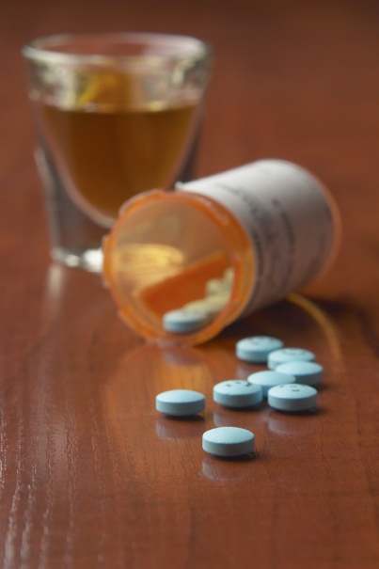
Drug Interactions
Drug interactions occur when a drug interacts with another drug, food, or alcohol and changes the way the drug acts in the body.
May cause unexpected side effect.
The drugs involved can be prescription medicines, over-the-counter medicines or vitamins and herbal products.
Examples:
Warfarin and antibiotics (e.g., levofloxacin (Levaquin)
Warfarin and green leafy vegetables
Alcohol and pain medicines (e.g., tramadol (Ultram)
Selective Serotonin Reuptake Inhibitor Antidepressants (e.g., sertraline (Zoloft) and St. Johns Wort
Grapefruit Juice and multiple medicines such as amlodipine (Norvasc) and simvastatin (Zocor)
BeMedWise

Slide 12
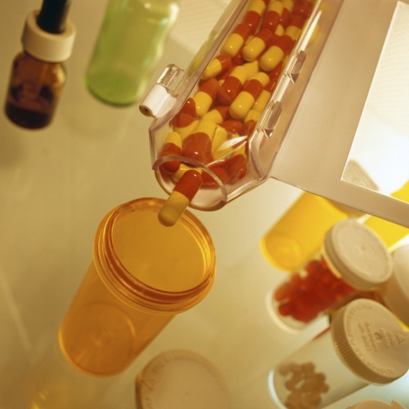
When Can Medicine Use Problems Happen?
When a new Medicine is added to the regimen.
When a Medicine is stopped.
When a Dose of a medicine is changed.
When alcohol is consumed while taking medicines.
When OTC and herbal products are taken without the doctor or pharmacist knowing they are part of the medicine regimen.
Can really happen any time.
BeMedWise

Slide 13
Ways to Avoid Medicine Use Problems
Communication
Asking questions to increase knowledge.
Talking to your healthcare providers.
Keeping an updated medicine list.
Using one pharmacy for all prescription medicines.
Medicine Review
Check your prescription prior to taking.
Have all medicines reviewed at least annually.
BeMedWise

Slide 14
Know Your Medicines!
What is this medicine used for?
Is this a BRAND or GENERIC?
Where do you store it?
How to take it?
How much?
How often/what time of day?
With or without food, with or without other medicines?
What should you expect or do?
How to tell if the medicine is working?
Possible side effects and what to do about them?
Tests or monitoring needed?
If you miss a dose?
BeMedWise

Slide 15
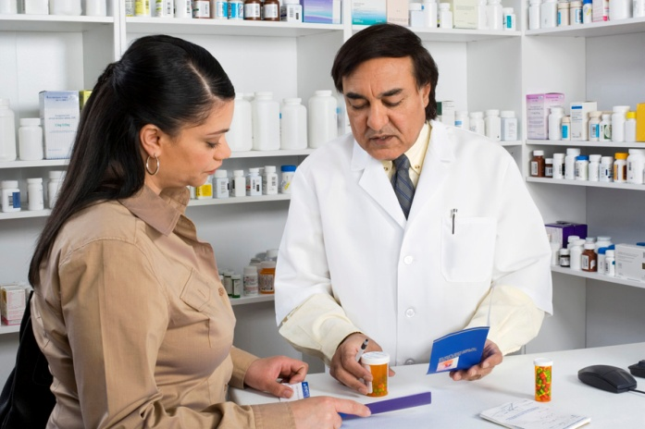
Your Medicine List
When visiting any healthcare professional:
Take your Medicine List, which contains information on:
All prescription medicines, including eye drops, topicals, samples.
Nonprescription medicines, herbals, vaccines
What are the medicines used for.
How to take the medicine.
BeMedWise

Slide 16
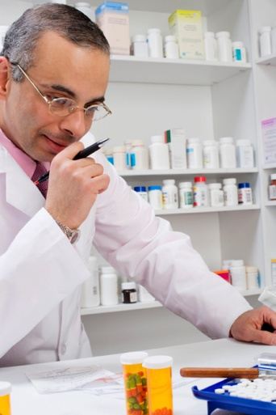
Your Medicine List
Make copies of your list.
Give one to your doctor, one to your pharmacist, and one to a loved one.
Carry one with you and keep a copy at home.
Make sure to keep it updated!
BeMedWise

Slide 17
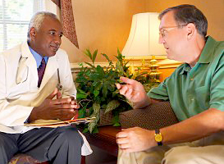
Talking with Your Healthcare Provider
Prior to your visit, make a list of questions.
Ask about:
Questions you may have about a disease, symptom(s), or medicines.
The need to continue current medicines.
Non-drug treatments
Over-the-counter preparations
Need for follow-up appointments, lab work.
You are an important part of your healthcare team!
BeMedWise

Slide 18
Ways to Avoid Medicine Use Problems: The OTC Drug Fact Label
All over-the-counter medicines in the United States have a Drug Facts Label that looks like this:
Learning to read the Drug Facts Label will give you the knowledge to make better decisions, and use OTC medicines safely.
BeMedWise

Slide 19
Reading the OTC Drug Fact Label
Active Ingredient(s): Chemical compound in the medicine that works with your body to bring relief.
Uses: This sections tells you the ONLY symptoms the medicine is approved to treat.
Warnings: This section tells you what to avoid and who should not use this.
Directions: Recommended daily dosage and frequency. Follow this strictly.
Other Information: Tells you additional information such as proper storage.
Inactive Ingredients: A chemical compound that has no effect on your body.
BeMedWise

Slide 20
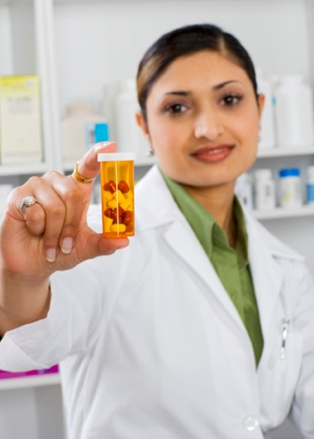
Ways to Avoid Medicine Use Problems: Written Information
The information sheet you get with your prescription medicine contains useful information to help you get the best results and avoid problems. Read it carefully.
The information sheet tells you:
What the medicine is used for.
How to take your medicine correctly.
What side effects to watch for and what to do if they occur.
Warnings and Precautions
Storage
BeMedWise

Slide 21
Review: Remember the 3 R’s for Safe Medicine Use
Risk - All medicines (prescription & nonprescription) have risks as well as benefits; and you need to weigh these risks and benefits carefully for every medicine you take.
Respect – Respect the power of your medicine and the value of medicines properly used.
Responsibility - Take responsibility for learning about how to take your medicine safely.
BeMedWise

Slide 22
Resources You Can Use
Safe Medicine Use Information:
www.bemedwise.org
AARP – https://www.aarp.org/
Drugs & Supplements – https://www.aarp.org/health/drugs-supplements/
Institute for Safe Medication Practices – www.ismp.org
U.S. Food and Drug Administration – www.fda.gov
www.fda.gov/medsinmyhome
Buying Medicines Safely on the Internet:
https://www.fda.gov/ForConsumers/ConsumerUpdates/ ucm04396.htm
BeMedWise

Slide 23
Contacts
BeMedWise

Slide 24
Meet the MUST for Seniors Development Team
TM
NCPIE wishes to thank the following individuals for their input in the development of the Medication Use Safety Training for Seniors™
^{(MUST for Seniors™) program:}
Nicole J. Brandt, PharmD, CGP, BCPP
Associate Professor, Geriatric Pharmacotherapy
Director, Clinical and Educational Programs
Peter Lamy Center for Drug Therapy and Aging
^{University of Maryland}
^{School of Pharmacy}
^{Baltimore, MD}
^{Lindsay DuVall Clarke}
^{Director of Health Programs}
^{Alliance for Aging Research}
^{Washington, DC}
^{Reba Cornman, MSW, LCSW-C}
Director, Geriatrics and Gerontology Education and Research Program
^{University of Maryland, and}
Director, Communications and Outreach
Peter Lamy Center for Drug Therapy and Aging
University of Maryland School of Pharmacy
^{Baltimore, MD}
BeMedWise

Slide 25
Meet the MUST for Seniors Development Team
TM
^{Debbie Gold}
Program Manager, GOSPEL Program
^{HHS/Office of Health Promotion}
^{Montgomery County Government}
^{Wheaton, MD}
^{Kathleen (Kay) Loughrey}
^{Consumer Services}
^{U.S. Administration on Aging}
^{Washington, DC}
^{Phylliss M. Moret, RPh}
Associate Executive Director / Chief Operating Officer
American Society of Consultant Pharmacists
^{Alexandria, VA}
BeMedWise

Slide 26
Meet the MUST for Seniors Development Team
TM
^{N. Lee Rucker, MSPH}
^{Senior Policy Advisor}
^{Public Policy Institute}
^{AARP}
^{Washington, DC}
University of Maryland
Chanel Agness, PharmD
Assistant Professor, University of Maryland School of Pharmacy
Jennifer Hardesty, PharmD
Consultant
BeMedWise

Slide 27
NCPIE Staff
^{Wm. Ray Bullman}
^{Executive Vice President}
National Council on Patient Information and Education
^{Bethesda, MD}
^{Deborah Davidson}
^{Membership Director}
National Council on Patient Information and Education
^{Bethesda, MD}
^{David Juste}
^{2007 Summer Intern}
^{SUNY @ Old Westbury}
^{Brooklyn, NY}
BeMedWise

Slide 28
Videography/Design
^{Louisa Hart}
^{Director}
The Cloudburst Consulting Group, Inc.
^{Landover, MD}
^{Marlene Povich}
^{Povich Design}
^{Bethesda, MD}
^{Alison Ray}
^{Editor}
^{GVI Video Productions}
^{Washington, DC}
^{John Seebode}
^{Office of Medical Education}
University of Maryland School of Medicine
BeMedWise

Slide 29
NCPIE is pleased to acknowledge AstraZeneca Pharmaceuticals for providing a charitable contribution to make the MUST for Seniors Program possible.
BeMedWise

